Slide 1
Conditional formatting
for data visualization

Slide 2

Data visualization !!!
Data visualization in Excel is a powerful tool to represent complex data in a graphical format, making it easier to interpret and analyze trends, patterns, and outliers. Excel provides various charting tools and features to help create clear and effective visualizations.

Slide 3

Steps to Create Data Visualizations
1. Prepare Your Data
2. Select the Data
3. Insert Chart: Some types of charts are ;
* Column Chart * Line Chart
* Pie Chart * Bar Chart
* Scatter Plot * Histogram
4. Customize Your Chart: Add Chart Title, Axis Titles, Data Labels, Legend, Data Labels, Colors & Styles
5. Use Conditional Formatting
6. Formatting and Enhancing:

Slide 4
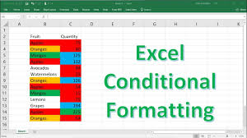
Conditional Formatting
Conditional Formatting in Excel allows you to format cells based on specific conditions or criteria. This feature helps highlight trends, patterns, or key insights in your data automatically. It's useful for making data-driven decisions quickly by visually analyzing large datasets.

Slide 5
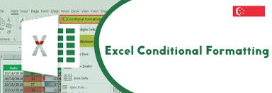
Steps to Use Conditional Formatting
In
Go to the Home tab on the ribbon.
1. Select the Range:
First, highlight the cells you want to apply conditional formatting. It could be a single column, a row, or an entire table.
2. Navigate to conditional formatting:
Go to the Home tab of the ribbon
In the styles group, click on conditional formatting
3. Choose a Rule: There are several types of conditional formatting rules.

Slide 6
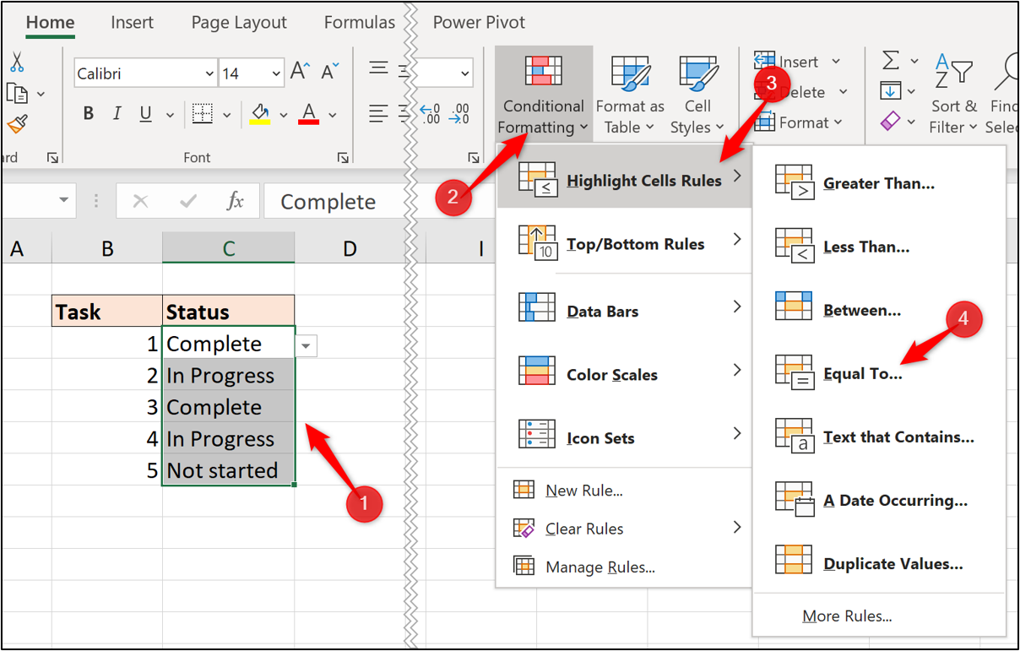
1. Highlight Cells Rules
These are predefined rules based on comparisons or conditions:
Greater Than / Less Than : Highlights cells that are greater than or less than a specified number.
Between: Highlights cells that fall within a certain range.
Equal To: Highlights cells equal to a particular value.
Text That Contains: Formats cells containing specific text.
A Date Occurring: Highlights dates that meet a certain condition (e.g., yesterday, today, last week).
Duplicate Values: Highlights all duplicates or unique values in the selected range

Slide 7
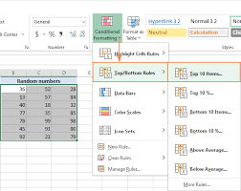
2. Top/Bottom Rules
These rules are used to highlight outliers:
Top 10 Items/Top 10%: Highlights the top 10 values or percentages.
Bottom 10 Items/Bottom 10%: Highlights the bottom 10 values or percentages.
Above/Below Average: Highlights cells that are above or below the average value of the range.
Example:
To highlight the top 5 sales values, select the range → Conditional Formatting → Top/Bottom Rules → Top 10 Items and change the value to 5.

Slide 8
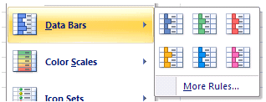
3. Data bars
Data bars provide a visual bar within each cell that shows the relative magnitude of values:
Positive and negative values can be differentiated by color.
The length of the bar represents the value in relation to the highest and lowest in the selected range.
Example:
Select your data range → conditional formatting → Data bars → choose a color

Slide 9
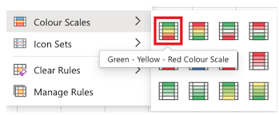
4. Color Scales
This rule applies gradient or color coding based on the cell's value:
The color gradient typically shifts from one color (e.g., red for low values) to another color (e.g., green for high values).
You can customize the scale from 2 to 3 colors.
Example:
To highlight performance from poor to excellent, select your data →Conditional formatting → Color scales → Choose the color scale.

Slide 10
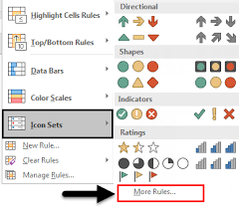
5. Icon Sets
Icon sets add icons (like arrows, circles, stars) to each cell based on its value:
This is helpful for categorizing data (e.g., red arrow for low, yellow for middle, green for high)
Example:
Select the data range → Conditional formatting → Icon set → Choose an icon set

Slide 11
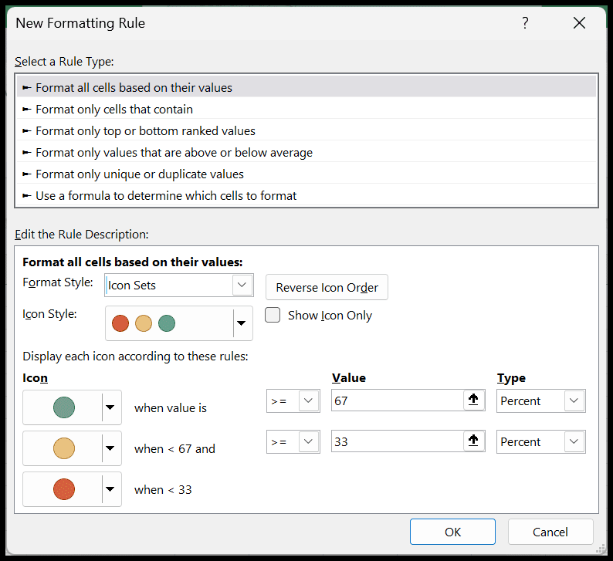
6. New Rule (Custom Rules)
For more advanced conditions, you can create a custom rule:
Example: click on conditional formatting →New rule
You can set formulas and criteria manually, giving you more flexibility (e.g., highlighting cells based on a complex condition).

Slide 12
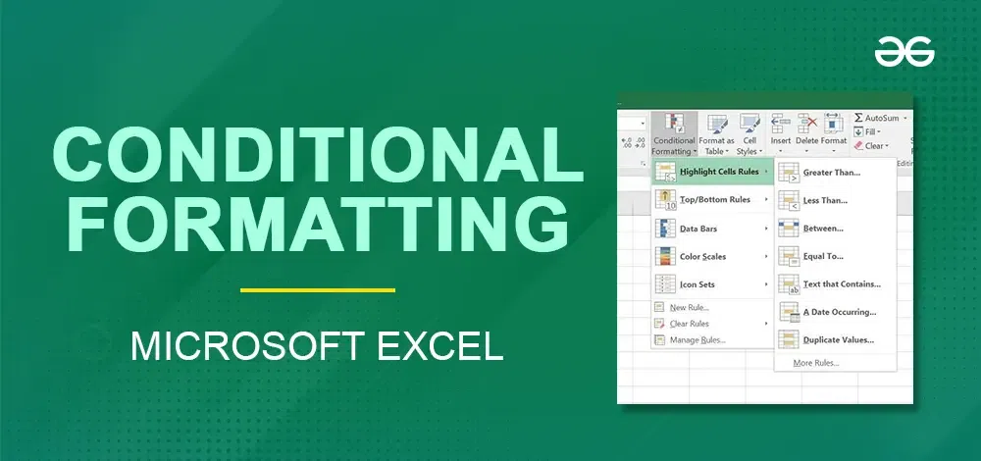
Conclusion
Conditional formatting is a powerful feature in Excel that allows to visually highlight, emphasize, or apply specific formatting to cells or ranges of cells based on certain conditions.It is commonly used to emphasize high or low values, identify duplicates, visualize data distribution, and more.This enhances the visual analysis of a data, making it easier to interpret the data by highlighting important information or trends.

Slide 13

Thank you !!!
ajaycraju98@gmail.com

